Slide 1


AltarStar gameplay

Slide 2
Basic Mechanics
Player
Dash/Dodge
Press button to do a short dash to avoid enemy fire.
Grapple
Hook on to certain objects to avoid enemy fire
Weapons
Blaster – weak, fast firing weapon
Missile – strong, slow shot weapon
Puzzles
Push blocks – push blocks out of the way
Trigger – bounce object off wall to hit it into trigger location
Key Triggers – After certain requirements, trigger activates and reveals the key/opens passage.
AI/Enemies
Enemy patrol
Basic small enemy
Low health
Normal blaster
Tough enemy
Larger size
Slower speed
Medium health
Medium blaster
Mini Boss
Very large
Medium speed
High health
Strong blaster

Slide 3
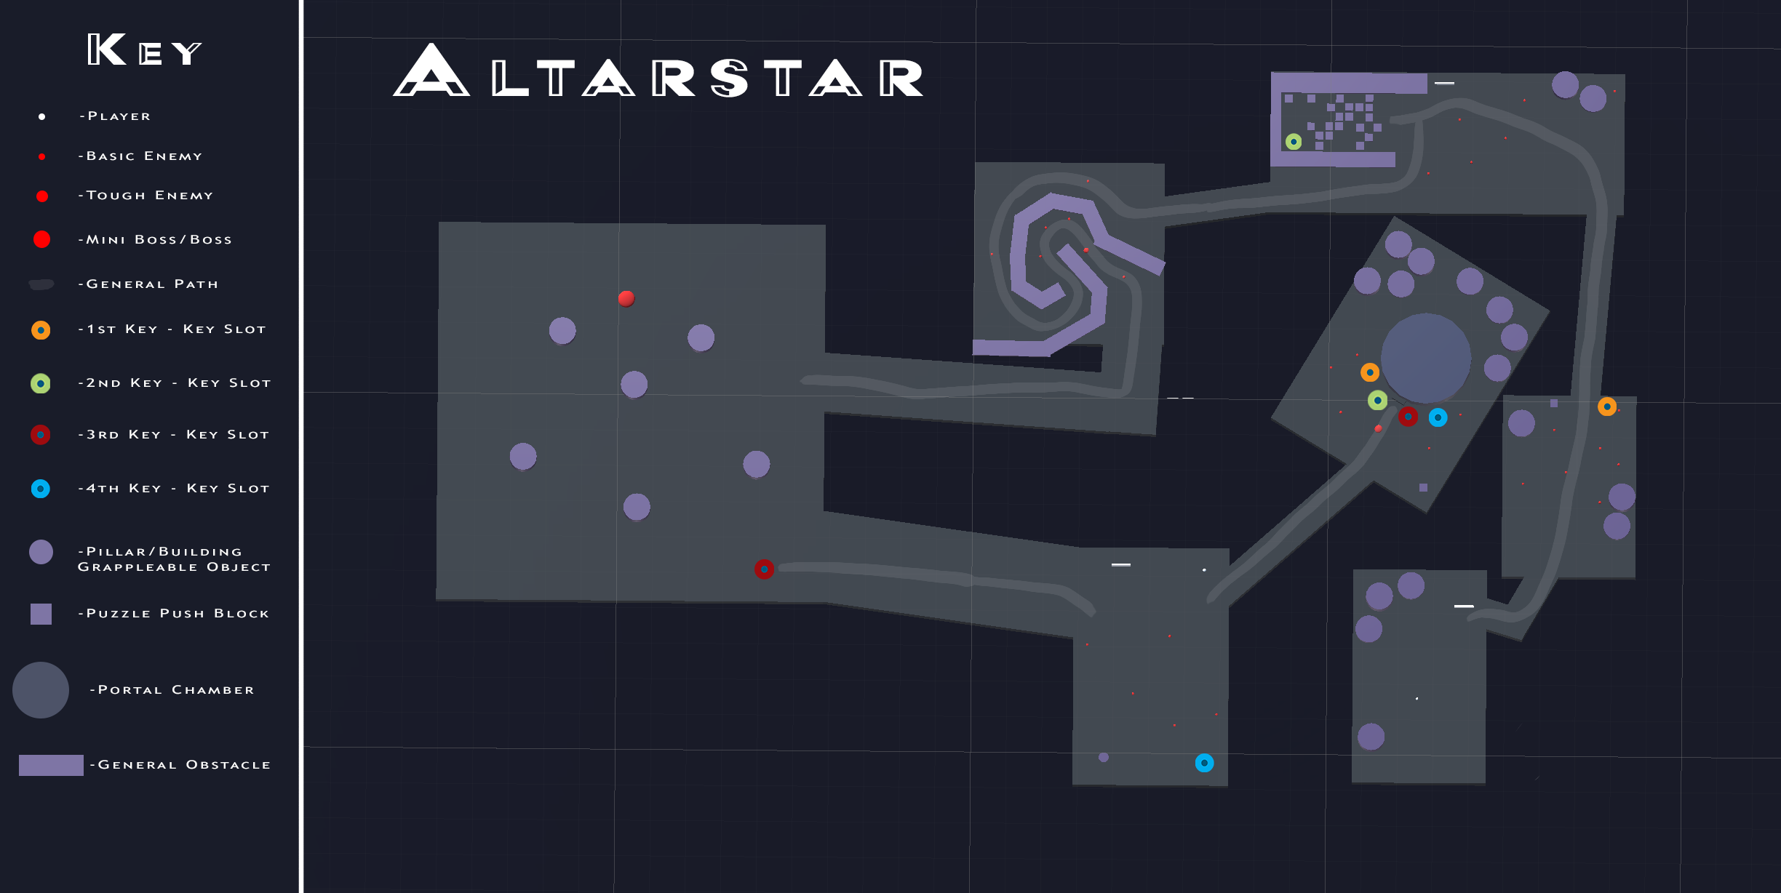

Slide 4
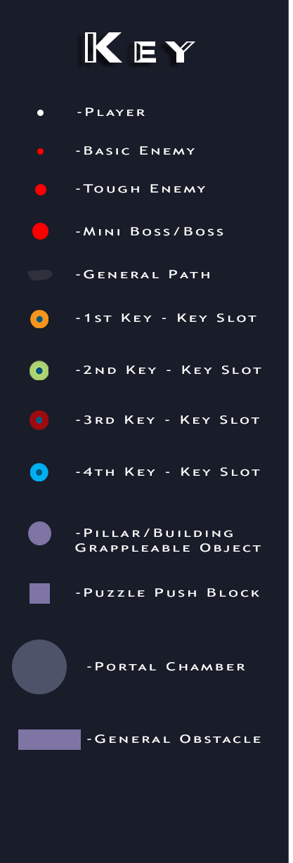
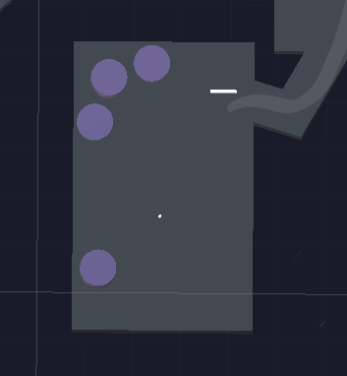
Start

Slide 5
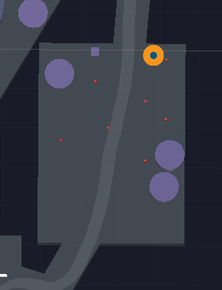
First Key

Slide 6
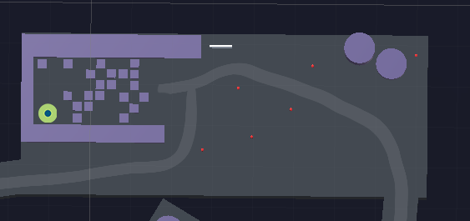
Second Key

Slide 7
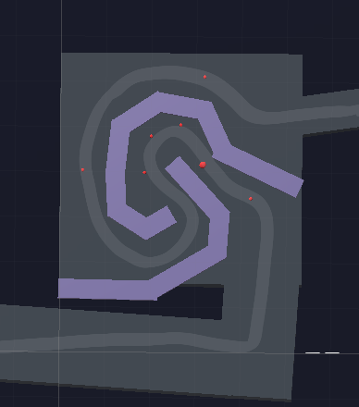
Grapple Upgrade

Slide 8
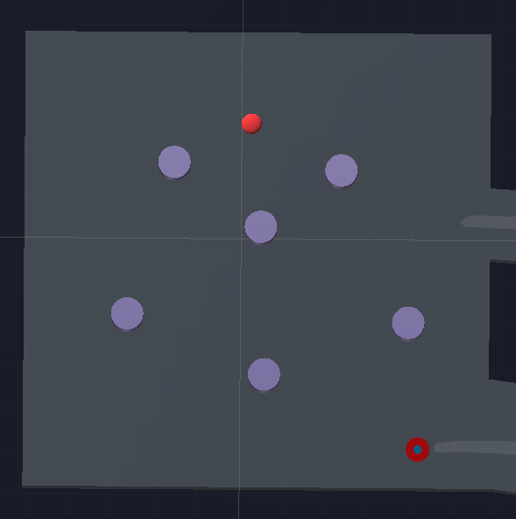
Mini Boss – Third Key

Slide 9
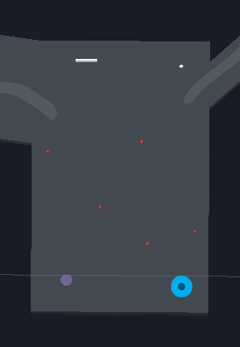
Fourth Key

Slide 10
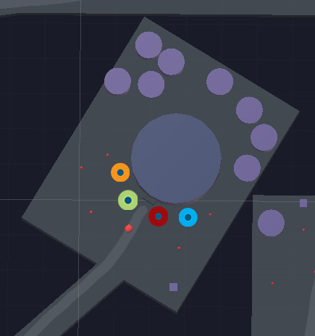
Portal Chamber Entrance

Slide 11
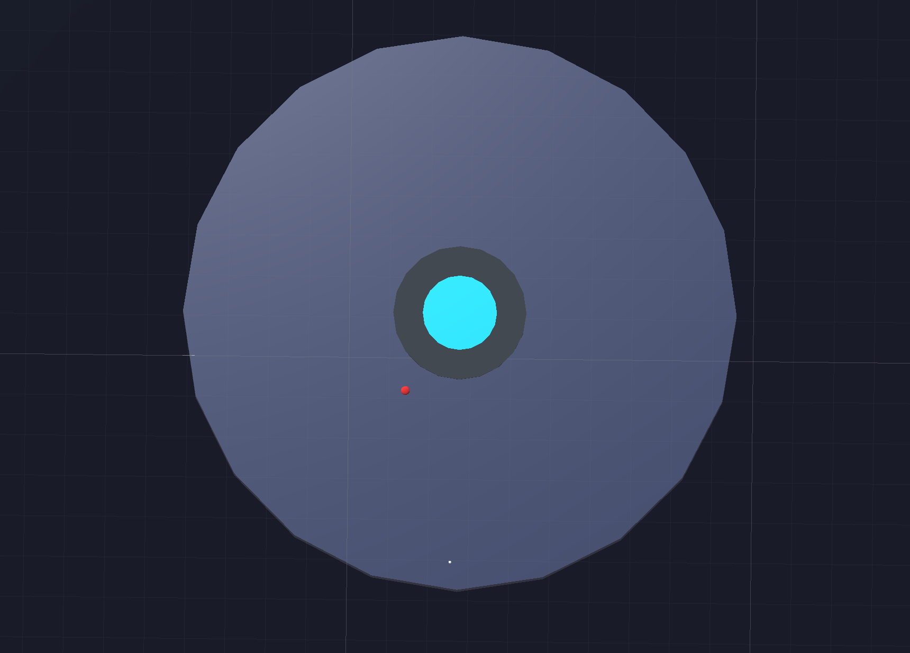
Portal Chamber

